Slide 1
Tutorial 1
Getting Started
Tiffany Wun || Fatemeh Rajabiyazdi
twwun@ucalgary.ca || frajabiy@ucalgary.ca

Slide 2
TODAY
Setting up the programming environment
First steps with HTML, CSS, & Javascript (+SVGs)
Drawing in the canvas

Slide 3
PROGRAMMING
We’ll be using Javascript in this course
Your code has to work in both Firefox + Chrome
Use any programming IDEs you want
Other recommendations:
JS Based IDE: JetBrains Webstorm
Free for students: https://www.jetbrains.com/student/
Can test compatibility with multiple browsers

Slide 4
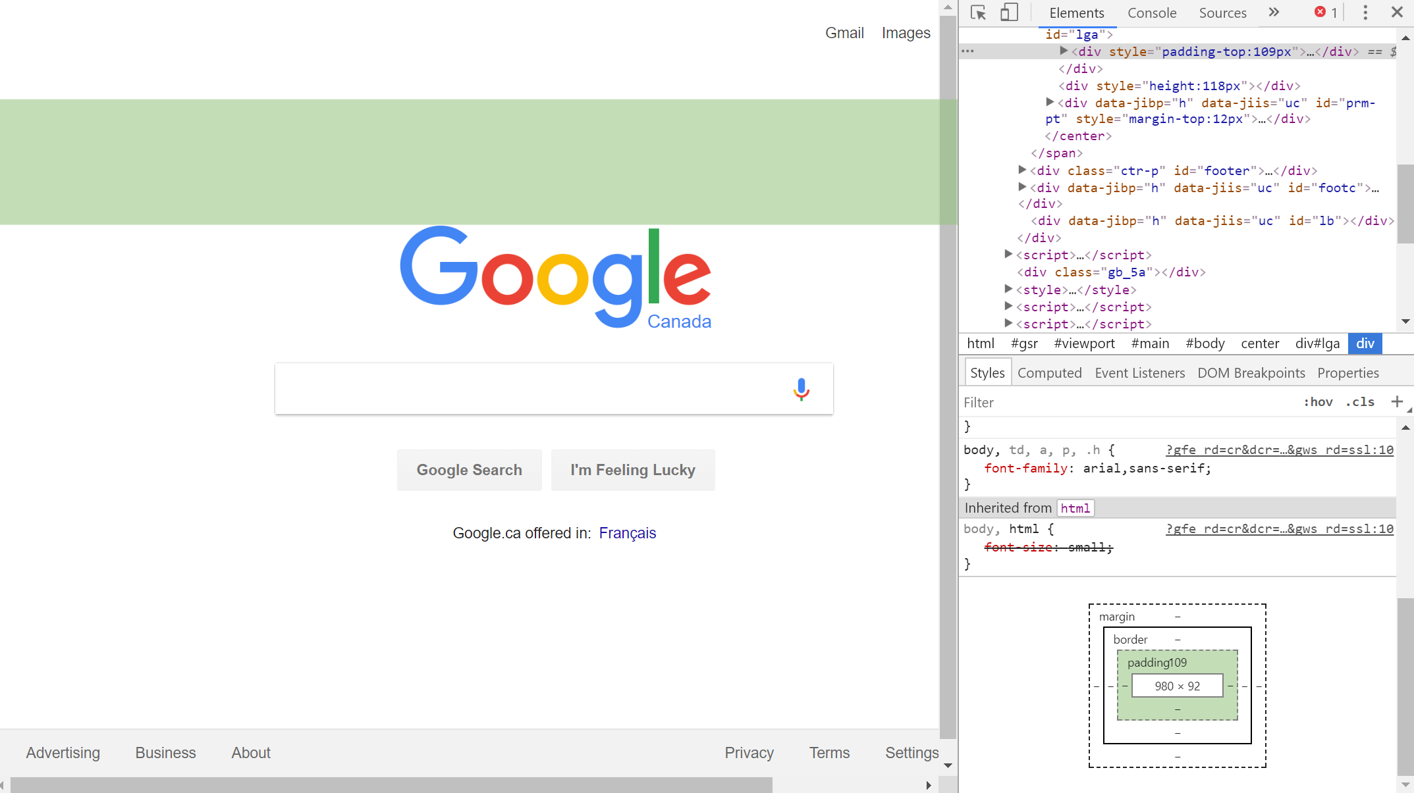
Chrome Developer Tools
Notes:
Chrome Developer Tools: Set of web authoring and debugging tools built into Google Chrome
I recommend this as it’s already built into the chrome browser
Should be equivalent for FF
(show a demo)

Slide 5
Demo
Notes:
Show console
Can right click on areas of the page and see what div it is in, and the css styles associated with it
Show how you can change css and html elements temporarily
You can even switch to a mobile/responsive UI design view

Slide 6
HTML, CSS, Javascript
HTML (Hyper Text Markup Link)
Markup language - defines what the content is
HTML5 is the current standard
CSS (Cascading Style Sheets)
Defines the style of an HTML page - how it should be displayed
Javascript
The programming language that defines the behaviour of the content
How are they connected

Slide 7
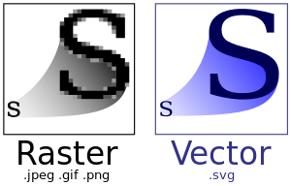
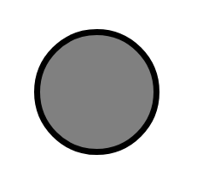
SVG
SVG (Scalable Vector Graphics)
Used to define vector based graphics
SVG is a language for describing 2D graphics in XML
Example:
<svg width="100" height="100"><circle cx="50" cy="50" r="40" stroke="black"stroke-width="4" fill="gray" /></svg>
Difference between raster vs vector graphics
Result is a circle
Notes:
SVG (Scalable Vector Graphics)
Used to define vector based graphics
SVG is a language for describing 2D graphics in XML
Vector graphics are resizeable and won’t lose their resolution
Example that appears is a circle

Slide 8
Download T1_start.zip from Tutorials on D2L
Notes:
Unzip it, and open the 3 files in a text editor

Slide 9
SETTING UP HTML
<!DOCTYPE html>
<meta charset="utf-8">
<html>
<head>
<title></title>
</head>
<body></body>
</html>
Metadata
Links to scripts & files
HTML content
Notes:
(This is already placed in start.html, just talk about it)
This is the basic html document.
<meta> defines metadata of your html document
<head> is where you will place your script and link tags to js and css files
<body> contains your html content

Slide 10
<div> TAGS
Let’s make a new div in <body>:
<div class = "class1" id = "myDiv">
<h1>Hello!</h1>
</div>
Divs define sections in your HTML document. Use them to format grouped elements in CSS
Notes:
Add this code to the HTML document
Divs define sections in your HTML document. Use them to format grouped elements in CSS.
Let's make a new div and add it into the <body> section

Slide 11
CLASSES & IDs in HTML
<div class = "class1 class2" id = "myDiv">...</div>
Classes and IDs distinguish your elements and are needed to reference them in CSS and JS.
IDs must be unique, and each element must have only one. Multiple elements can have the same class, and the same element can have multiple classes.
Notes:
Don’t need to demo this slide, just talk about it
Classes and IDs distinguish your elements and are needed to reference them in CSS and JS.
IDs must be unique, and each element must have only one. Multiple elements can have the same class, and the same element can have multiple classes.

Slide 12
CSS
html, body{
height: 100vh;
width: 100vw;
margin: 0 auto;
padding: 0;
position: absolute;
}
vh/vw are the viewport window’s height & width
These divs are positioned from (0, 0)
Check the W3 documentation for style properties
Notes:
Don’t demo this, it’s already added in start.css
vh/vw are the viewport window’s height & width
These divs are positioned from (0, 0)
Check the W3 documentation for style properties

Slide 13
CSS
Add this to start.css:
h1{
font-family: 'Courier New';
color: blue;
}
#myDiv{
border: 3px dashed black;
}
To reference a class, use .classname
To reference an id, use #idname
Notes:
Add h1 function to the css file, then DEMO & show text has changed
To reference a class, use .classname
To reference an id, use #idname

Slide 14
THE <canvas> TAG
The canvas is a container for drawing graphics in JS.
Use the <canvas> element in HTML to draw graphics using JS
Between the <body> tags, add:
<canvas id = "myCanvas" width = "400" height = "400"></canvas>
There are two types of primitives in the canvas: rectangles and paths
X
Y
Canvas Coordinates
Notes:
Put this code into start.html
Canvas coordinates start from the top left

Slide 15
SETTING UP THE CANVAS
Change the <body> tag to:
<body onload = init()>
The init() function ensures that your code will only start running after the body elements are loaded
Add to start.js:
var canvas;
var context;
function init(){
canvas = document.getElementById('myCanvas');
context = canvas.getContext("2d");
}
When the browser is loaded, an HTML DOM(Document Object Model) is created, allowing JS to work with HTML/CSS elements. This function accesses the myCanvas element.
getContext(“2d”) returns a context object with methods/properties for drawing on canvas
Notes:
Add this code to start.html and start.js
Adding the init function is important, as it ensures that your code will only run after the body elements are loaded.
When the browser is loaded, an HTML DOM(Document Object Model) is created, allowing JS to work with HTML/CSS elements. This function accesses the myCanvas element.
getContext(“2d”) returns a context object with methods/properties for drawing on canvas

Slide 16
DRAWING ON THE CANVAS
function drawRectangle(){
context.fillStyle = "red";
context.fillRect(0, 0, 100, 100);
context.strokeRect(100, 100, 100, 100);
}
Call this function in init()
fillRect(x, y, w, h)
Notes:
Add this code in start.js. then DEMO and show the two rectangles
First define the fill to be red, then draw one red rectangle. Positioned at 0, 0, and it is 100px wide and high
We can draw a second rectangle with only the outline, with the same width and height, but at (100, 100)

Slide 17
DRAWING ON THE CANVAS
function drawCircle(){
context.fillStyle = "orange";
context.lineWidth = 5;
var circle = new Path2D();
circle.arc(100, 100, 50, 0, 2*Math.PI, false);
context.stroke(circle);
context.fill(circle);
}
Call this function in init()
Path2D() is a new feature in HTML5 which can save paths into variables for redrawing
arc(x, y, radius, radianStartAngle, radianEndAngle, anticlockwise)
Notes:
Add this code in start.js. Call in init(), then DEMO and show the circle
To draw a circle, we define the fillStyle to be orange, and a line width of 5px. Then we define circle as a Path2D function, which is a new feature in HTML5 which can save paths into variables for redrawing.
When calling the arc function, make sure to use radians
Then draw the outline and fill the color

Slide 18
A NOTE ABOUT <canvas> vs SVG
NOTE: <canvas>!= SVG
Canvas draws 2D graphics pixel by pixel.
If you need to change a graphic, the entire canvas must be redrawn.
No support for event handlers
SVG is XML based, and accessible in the DOM.
Can be auto re-rendered by browser if attributes of the SVG element are changed.
You can attach JS event handlers to SVG elements.
See https://www.w3schools.com/html/html5_svg.asp for more details
Notes:
Talk about the distinction between canvas vs svgs
Canvas draws 2D graphics pixel by pixel. If you need to change a graphic, the entire canvas must be redrawn.
No support for event handlers
SVG is XML based, and accessible in the DOM.
Shapes can be auto re-rendered by browser if attributes of the SVG element are changed.
You can attach JS event handlers to SVG elements.

Slide 19
NEXT TUTORIAL
JQuery and Intro to D3
Loading data
Hosting your assignments on the CPSC servers
...

Slide 20
USEFUL RESOURCES
https://www.w3schools.com/
HTML/CSS/JS Documentation & Tutorials
https://caniuse.com/
CSS cross compatibility checker
http://howtocenterincss.com/
Different methods of centering in CSS
https://developers.google.com/speed/libraries/
Most commonly used JS libraries, hosted by Google

